Slide 1
Image Compression
Image compression is used to make image file size smaller so that they take up less space on computer and can be shared faster over the internet. The goal is to reduce the file size without changing how the image looks.

Slide 2
Consider a black and white image that has a resolution of 1000*1000 and each pixel uses 8 bits to represent the intensity. So the total no of bits required = 1000*1000*8 = 80,00,000 bits per image. And consider if it is a video with 30 frames per second of the above-mentioned type images then the total bits for a video of 3 secs is: 3*(30*(8, 000, 000))=720, 000, 000 bits
So to store a 3-sec video we need so many bits which can be problematic as it takes up so much storage. Thus image compression plays an important role in this.

Slide 3
Image compression has two prime categories –
Lossless image compression
Lossy image compression
These vary based on the image file resizing process.

Slide 4
Lossless Compression
Lossless compression refers to a process of resizing the images into a smaller version. This technique does not fiddle with the image quality.
Though it is an excellent method to resize your image files, the outcome may still not be too small. That is because lossless compression does not eliminate any part of the image.
For example, it will convert an image of 15 MB to 10 MB. However, it will still be too large to display on a webpage.

Slide 5
Lossless image compression is particularly useful when compressing text. That is because a small change in the original version can dramatically change the text or data meaning.

Slide 6
Lossy Compression
Lossy compression reduces the image size by removing some of the image parts. It eliminates the tags that are not very essential.
If you opt for this method, you can get a significantly smaller version of an image with a minimal quality difference. Additionally, you can enjoy a faster loading speed.

Slide 7
Lossy compression works with a quality parameter to measure the change in quality. In most cases, you have to set this parameter. If it is lower than 90, the images may appear low quality to the human eye.
For example, you can convert an image of 15 MB into 2200 Kb as well as 400 Kb.
JPG,MPEG,Mp3 all use lossy compression.
Our eyes cannot distinguish subtle changes so lossy data is acceptable.

Slide 8
Which type of image compression is the best for you?
Websites like retail, blog, and portfolio have a lot of images. In these cases, lossy compression will prove to be beneficial as it reduces the size and improves the page speed.
On the other hand, a photography business or medical image center must use lossless compression. This method will preserve the image quality.

Slide 9
Decompression
Reverse operation where the redundant parts are put back into the representation to restore it to it’s initial form.

Slide 10
Data contains irrelevant or repeated imformation called redundant data.
Types of Data Redundancies
Coding redundancy
Spatial and Temporal Redundancy
Irrelevant Information

Slide 11
Image compression targets three main types of redundancy:
Coding Redundancy - inefficient bit usage
Interpixel(Spatial) - correlation between neighboring pixels
Psychovisual Redundancy - (information less perceptible to the human eye). By identifying and reducing these overlaps, compression algorithms significantly decrease file sizes for storage and transmission.

Slide 12
Image Compression
Image compression system is composed of two distinct functional components: an encoder and a decoder.
The encoder performs compression, and the decoder performs the complementary operation of decompression.
Both operations can be performed in software, as is the case in Web browsers and many commercial image-editing applications, or in a combination of hardware and firmware, as in commercial DVD players.
A codec is a device or program that is capable of both encoding and decoding.

Slide 13
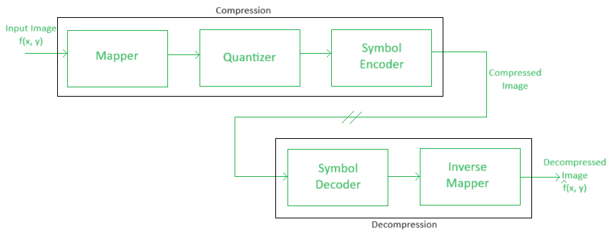
Functional block diagram of image compression system

Slide 14
Input image f (x,…) is fed into the encoder, which creates a compressed representation of the input. This representation is stored for later use, or transmitted for storage and use at a remote location.
When the compressed representation is presented to its complementary decoder, a reconstructed output image ˆf (x…) is generated.
In still-image applications, the encoded input and decoder output are f(x,y) and ˆf(x, y), respectively.
In video applications, they are f(x,y,t) and ˆf (x,y,t), where the discrete parameter t specifies time.

Slide 15
In general, ˆf (x,…) may or may not be an exact replica of f (x,…).
If it is, the compression system is called error free, lossless, or information preserving.
If not, the reconstructed output image is distorted, and the compression system is referred to as lossy.

Slide 16
The Encoding or Compression Process
The encoder is designed to remove the redundancies through a series of three independent operations.
In the first stage of the encoding process, a mapper transforms f(x,…) into a (usually nonvisual) format designed to reduce spatial and temporal redundancy. This operation generally is reversible, and may or may not directly reduce the amount of data required to represent the image. Run-length coding is an example of a mapping that normally yields compression in the first step of the encoding process.
Non-visual is not directly perceivable as an image because it converts spatial pixel intensity data into mathematical frequency coefficients.

Slide 17
In video applications, the mapper uses previous (and, in some cases, future) video frames to facilitate the removal of temporal redundancy.

Slide 18
The quantizer maps a large set of input pixel or transform coefficient values to a smaller, finite set of reconstruction levels to reduce file size. The goal is to keep irrelevant information out of the compressed representation.
This operation is irreversible. It must be omitted when error-free compression is desired.

Slide 19
In the third and final stage of the encoding process, the symbol coder generates a fixed-length or variable-length code to represent the quantizer output, and maps the output in accordance with the code.
In many cases, a variable-length code is used. The shortest code words are assigned to the most frequently occurring quantizer output values, thus minimizing coding redundancy.
This operation is reversible.
Upon its completion, the input image has been processed for the removal of each of the three redundancies

Slide 20
An image decoder is essential in image compression to reverse the encoding process, transforming compact, encoded data back into a viewable, high-quality image format.
It reconstructs visual information from compressed files, essential for storage and transmission, especially in lossy compression where it restores data while minimizing distortion.

Slide 21
The Decoding or Decompression Process
The decoder contains only two components:
symbol decoder and an inverse mapper.
They perform, in reverse order, the inverse operations of the encoder’s symbol encoder and mapper.
Because quantization results in irreversible information loss, an inverse quantizer block is not included in the general decoder model.

